Slide 1
High Assurance Rigorous Digital Engineering for Nuclear Safety (HARDENS)
Joe Kiniry, Galois (kiniry@galois.com)
May 2022
Theme: Driving FM to Practice
Keywords: digital engineering, model-based engineering, software engineering, hardware engineering, safety engineering, requirements engineering, formal verification, rigorous runtime verification, Cryptol, SAW, ACSL, SysML, FRET, RISC-V
This work is supported by the U.S. Nuclear Regulatory Commission (NRC), Office of Nuclear Regulatory Research, under contract/order number 31310021C0014.
All material is considered in development and not a finalized product.
Any opinions, findings, conclusions or recommendations expressed in this material are those of the author(s) and do not necessarily reflect the views of the NRC.
Notes:
Abstract: I’ve been leading R&D in various forms of high-assurance engineering for around 25 years. The U.S. Government has gotten excited recently about this kind of engineering, and they call it Digital Engineering (DE). Despite the excitement, there is quite a bit of confusion—even on the part of the Government—about what Digital Engineering really is. Likewise, there is confusion about what it is inside of Galois, despite the fact that we now have over a half dozen projects that focus on the topic. This talk is meant to help clarify the topic, as well as explain and demonstrate, through a case study, what Rigorous Digital Engineering (RDE) is. The High Assurance Rigorous Digital Engineering for Nuclear Safety (HARDENS) project for the Nuclear Regulatory Commission (NRC) is a small project that demonstrates RDE in practice. So if you are curious about what all the buzz is about DE and RDE—or you just want to learn about the state of the art in today’s nuclear control systems and their future—come to this talk and ask questions!

Slide 2


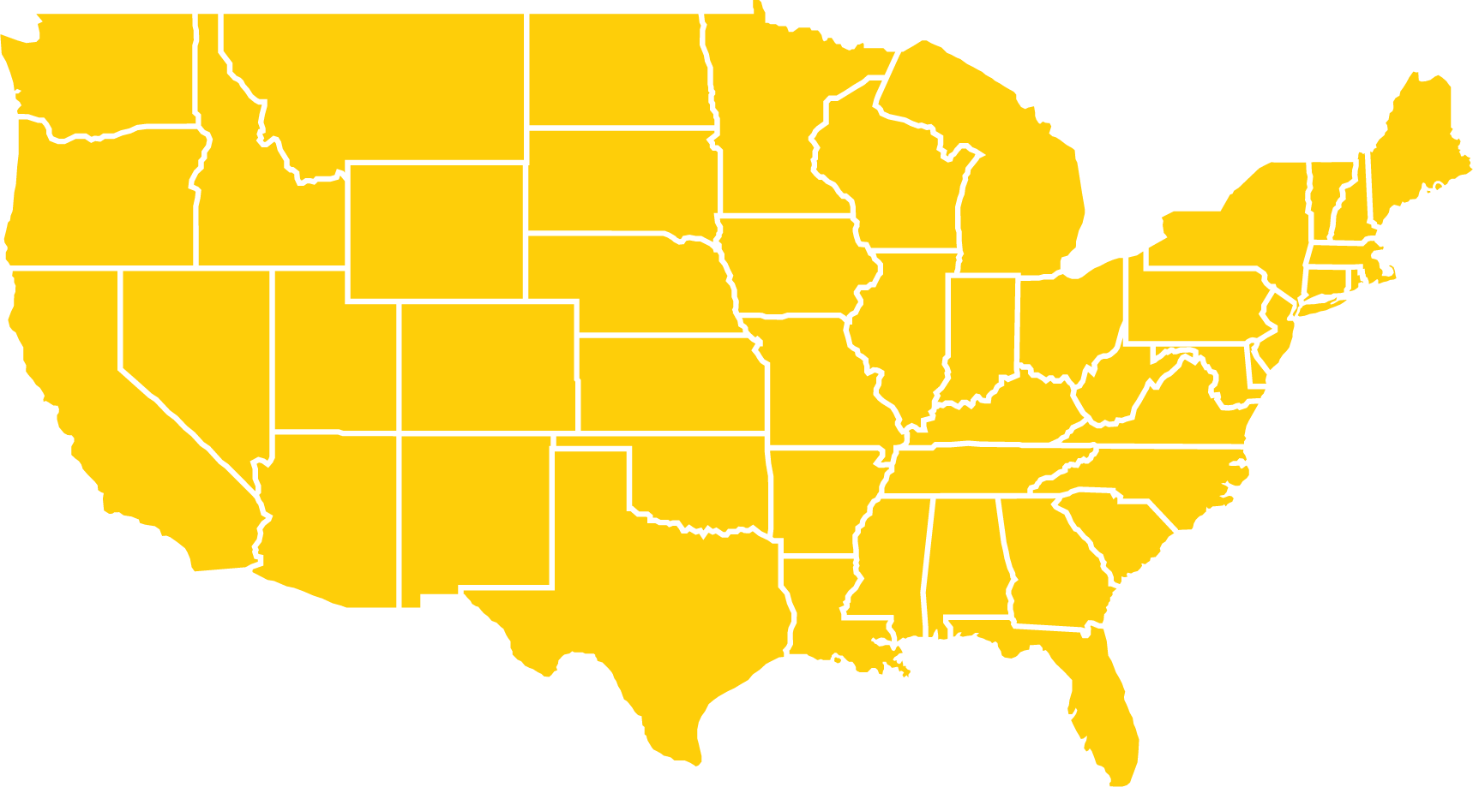

Correctness
Cryptography
Security
AI and ML
Advancing computer science R&D Creating trustworthiness in critical systems
Clients
Offices
History
DOE DHS
DARPA AMAZON
NASA NIST
Portland, OR Dayton, OH Arlington, VA
Founded in 1999
100+ employees
A different kind of company
No managers
We have no fixed hierarchy of rigid positions and titles, and no traditional managers.
Choose your work
Research engineers choose the projects they work on, and move freely between projects depending on personal interests and career goals.
Radical transparency
Everything is transparent by default: company financials, decision making, open meetings, and even salaries.
Ownership
Employees own the majority of the company together, making important decisions as a group and partaking in the financial success of the company.
More info at lifeatgalois.com
Notes:
We solve hard computer science problems.
We’re hiring! And it’s a pretty unusual and delightful place to work at.

Slide 3
Outline
What is Rigorous Digital Engineering (RDE)?
The HARDENS Case Study
Where is RDE going next?

Slide 4
What is
Rigorous Digital Engineering (RDE)?

Slide 5
The RDE Research Program
Rigorous Digital Engineering (RDE)
Rigorous = use applied formal methods to reason about models, implementations, and evidence
Digital = use digital, mechanized, computational, denotational and executable models of components and systems to create digital twins (executable digital representations of components and systems ) and digital threads (relations between digital and physical artifacts with known, evidence-based fidelity)
Engineering = process, methodologies, tools, and technologies supporting all forms of engineering (particularly domain, requirements, product line, software, firmware, hardware, safety, systems, reverse, and security engineering)

Slide 6
Impact
adopting RDE ideas typically…
decreases effort, and thus cost
shortens POPs
changes focus and shifts thinking “left” and “up”
significantly decreases the volume and changes the nature of bugs found during development
increases assurance and changes its nature
helps certification, risk analysis, and transition

Slide 7
The Technologies of RDE
The technology stacks supported thus far by the RDE methodology include:
many different kinds of programming languages (procedural, object-oriented, functional, hardware, logic, and mixed-model, such as C, C++, C#, Rust, Haskell, Java, Scala, Kotlin, Eiffel, Chisel, Bluespec SystemVerilog, System Verilog, VHDL),
specification and modeling languages (such as F*, ACSL, JML, CodeContracts, Alloy, Z, VDM, Event-B, RAISE),
architecture specification tools and languages (such as Cameo, Rhapsody, MagicDraw, OSATE, Visual Paradigm and UML, AADL, and SysML, resp.),
integrated development environments (such as Eclipse, Visual Studio, VS Code, IDEA, Eagle, KiCAD, mbeddr, Rodin, OSATE, Crescendo, etc.),
formal modeling and reasoning tools (such as Alloy, PVS, Coq, Isabelle, UPPAAL, CZT, Overture, Rodin, Frama-C, SAW, Ivy, TLA Toolbox, FDR4, NuSMV, BLAST, and SPIN),
operating systems (RTOSs, UNIX variants, seL4, etc.), and
spans systems, hardware (ASIC and FPGA-based), firmware, and software

Slide 8
The HARDENS Case Study

Slide 9
HARDENS
HARDENS (High Assurance Rigorous Digital Engineering for Nuclear Safety) is a R&D project run by Galois for the Nuclear Regulatory Commission (NRC)
the purpose of HARDENS is to demonstrate and educate about cutting-edge, high-assurance model-driven engineering
our focus is on nationally critical infrastructure, and thus safety-critical embedded systems
within HARDENS, Galois has designed and built a demonstration Reactor Trip System (RTS) that is representative of a Digital Instrumentation & Control (DI&C) system for a Nuclear Power Plant (NPP)
the RTS is fault-tolerant and high-assurance
the RTS has a physical manifestation (an FPGA board plus sensors/actuators) and a set of digital twins

Slide 10
The Reactor Trip System (RTS)
a seemingly simple control system that measures temperature and pressure of a reaction vessel and actuates solenoids to open and close valves
representative of a class of systems that are deemed nationally critical infrastructure by the DHS
a fault-tolerant system with heterogenous redundancy
must fulfill a set of assurance “characteristics” found in the IEEE Standard 603-2018 “IEEE Standard Criteria for Safety Systems for Nuclear Power Generating Stations”

Slide 11
Digital Instrumentation & Control
The RTS is a demonstration DI&C system, which…
are basically sense-compute-control architectures that control safety-critical systems,
have human-in-the-loop user interfaces,
commonly have built-in self-test subsystems that must be able to self-test/assure a system while it is in operation,
are fault-tolerant and have heterogenous components, where components are implemented using multiple techniques, sometimes by multiple teams, and have multiple redundant connectors,
are built today within the NPP industry without software or COTS hardware, and
the NRC does not want to see the industry repeat the technology mistakes of other nationally critical infrastructure industries.

Slide 12
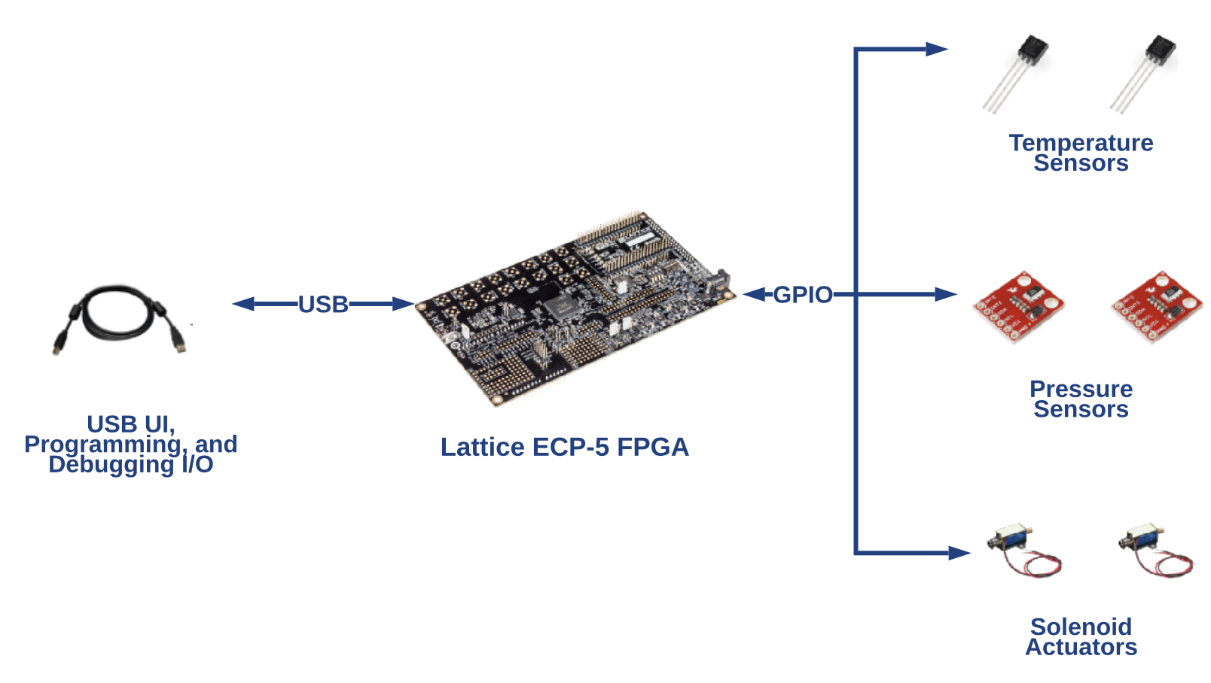
The RTS Hardware Artifacts

Slide 13
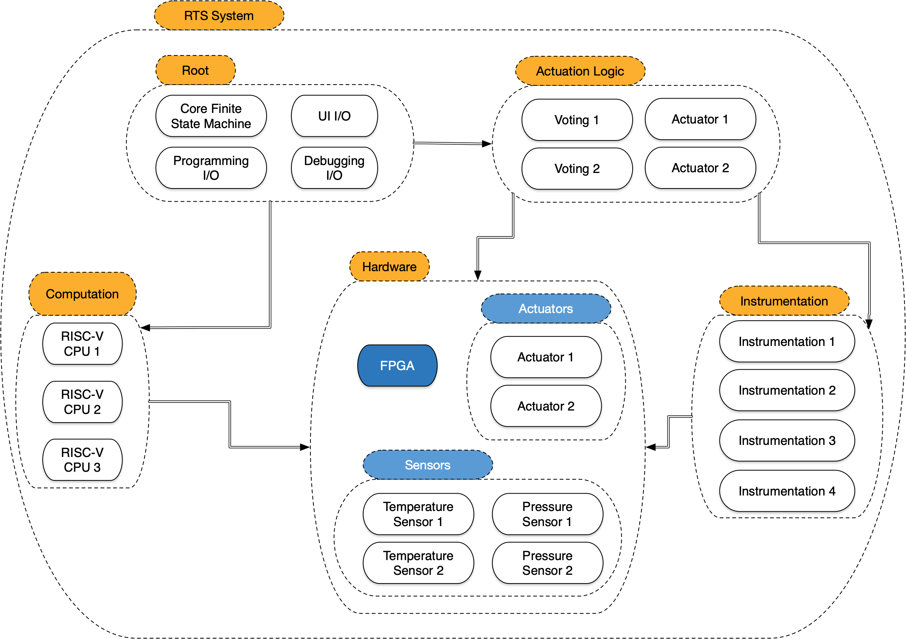
System Architecture

Slide 14
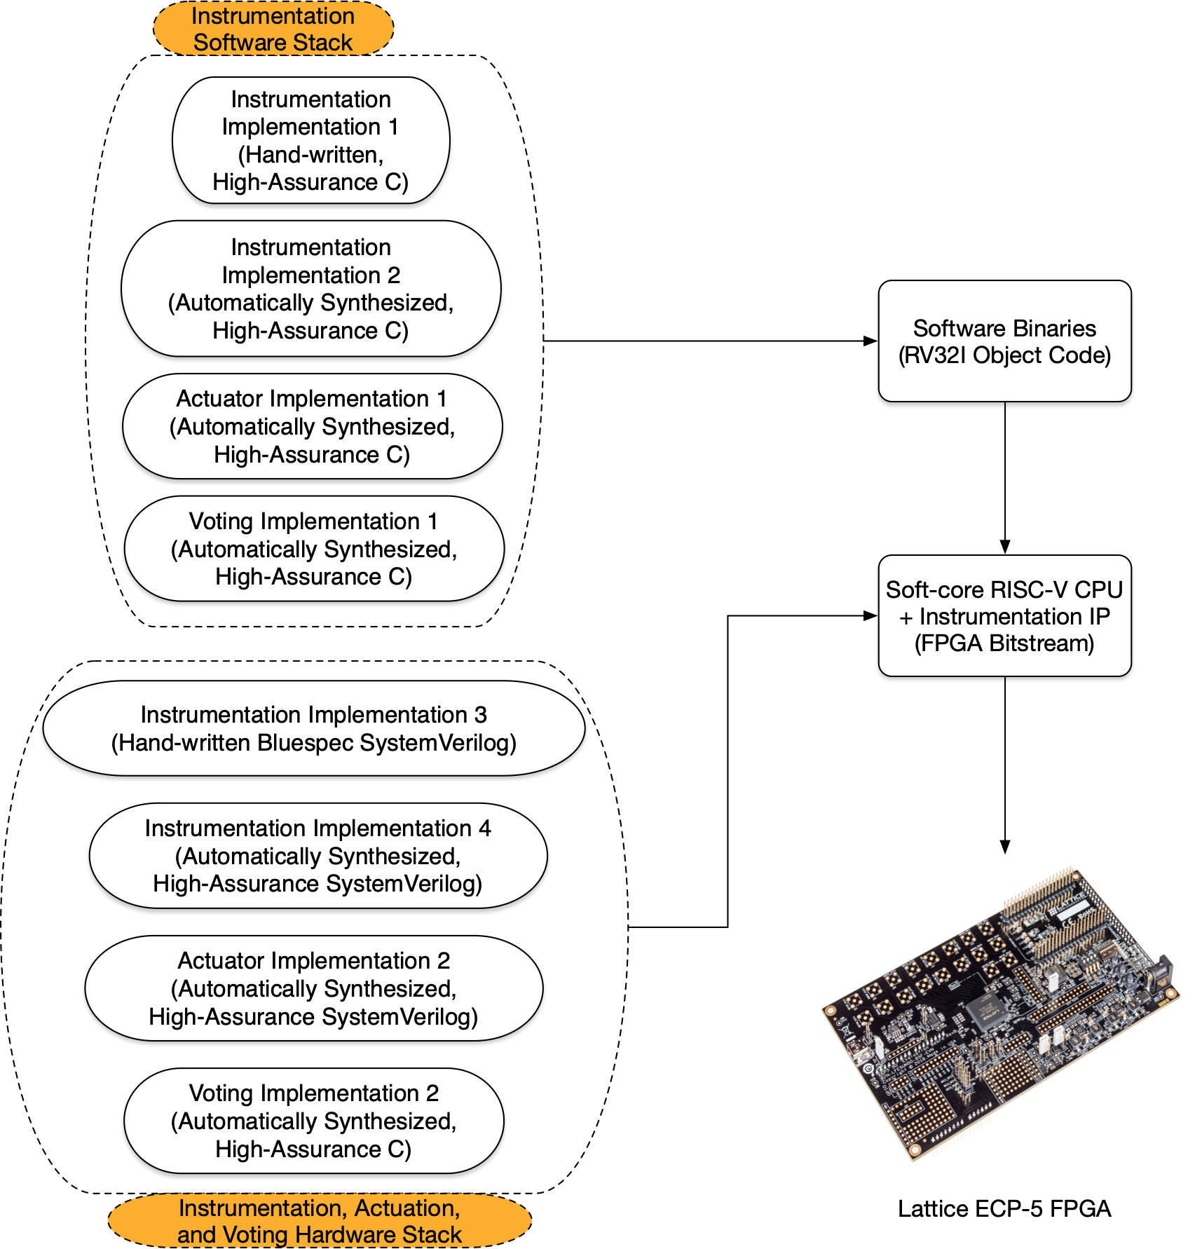
RTS Instrumentation Architecture

Slide 15
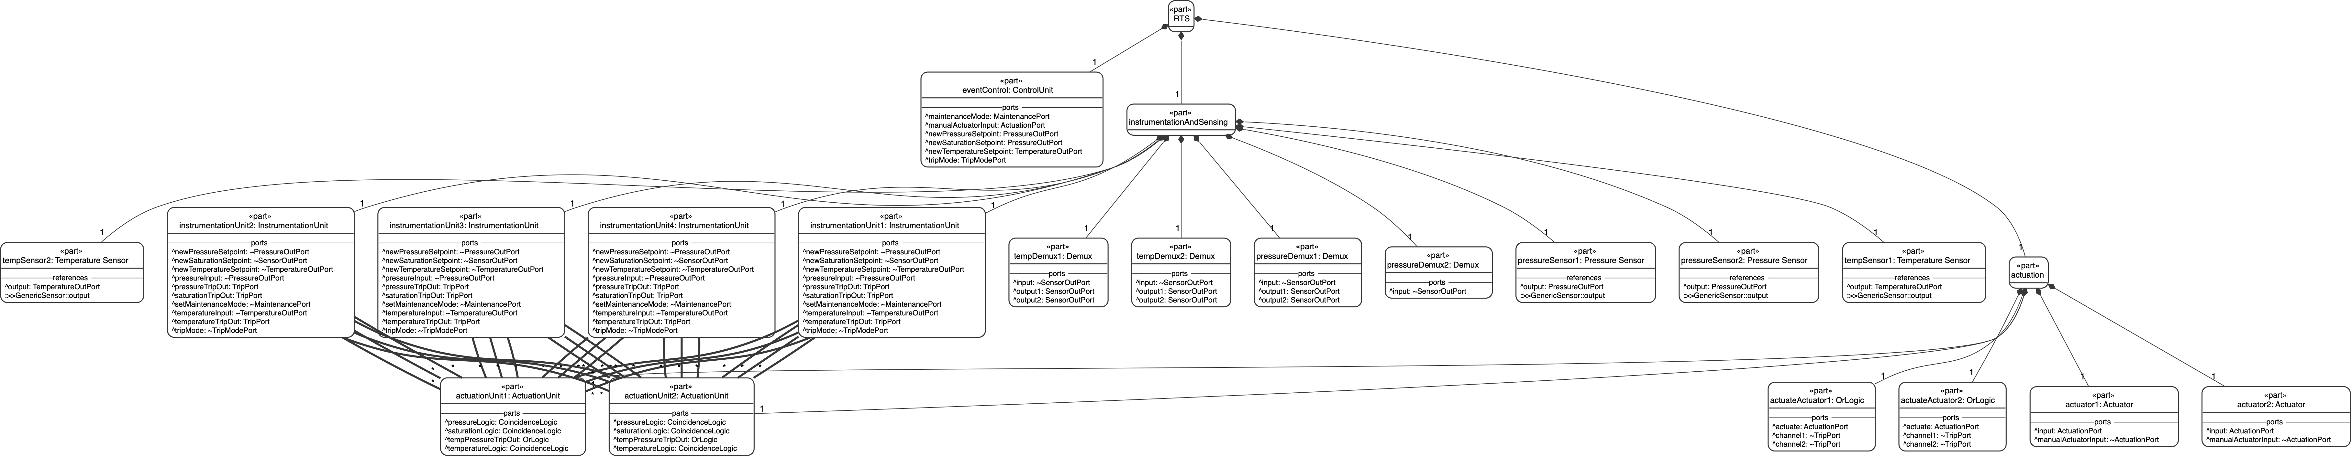
RT System Architecture in SysMLv2

Slide 16
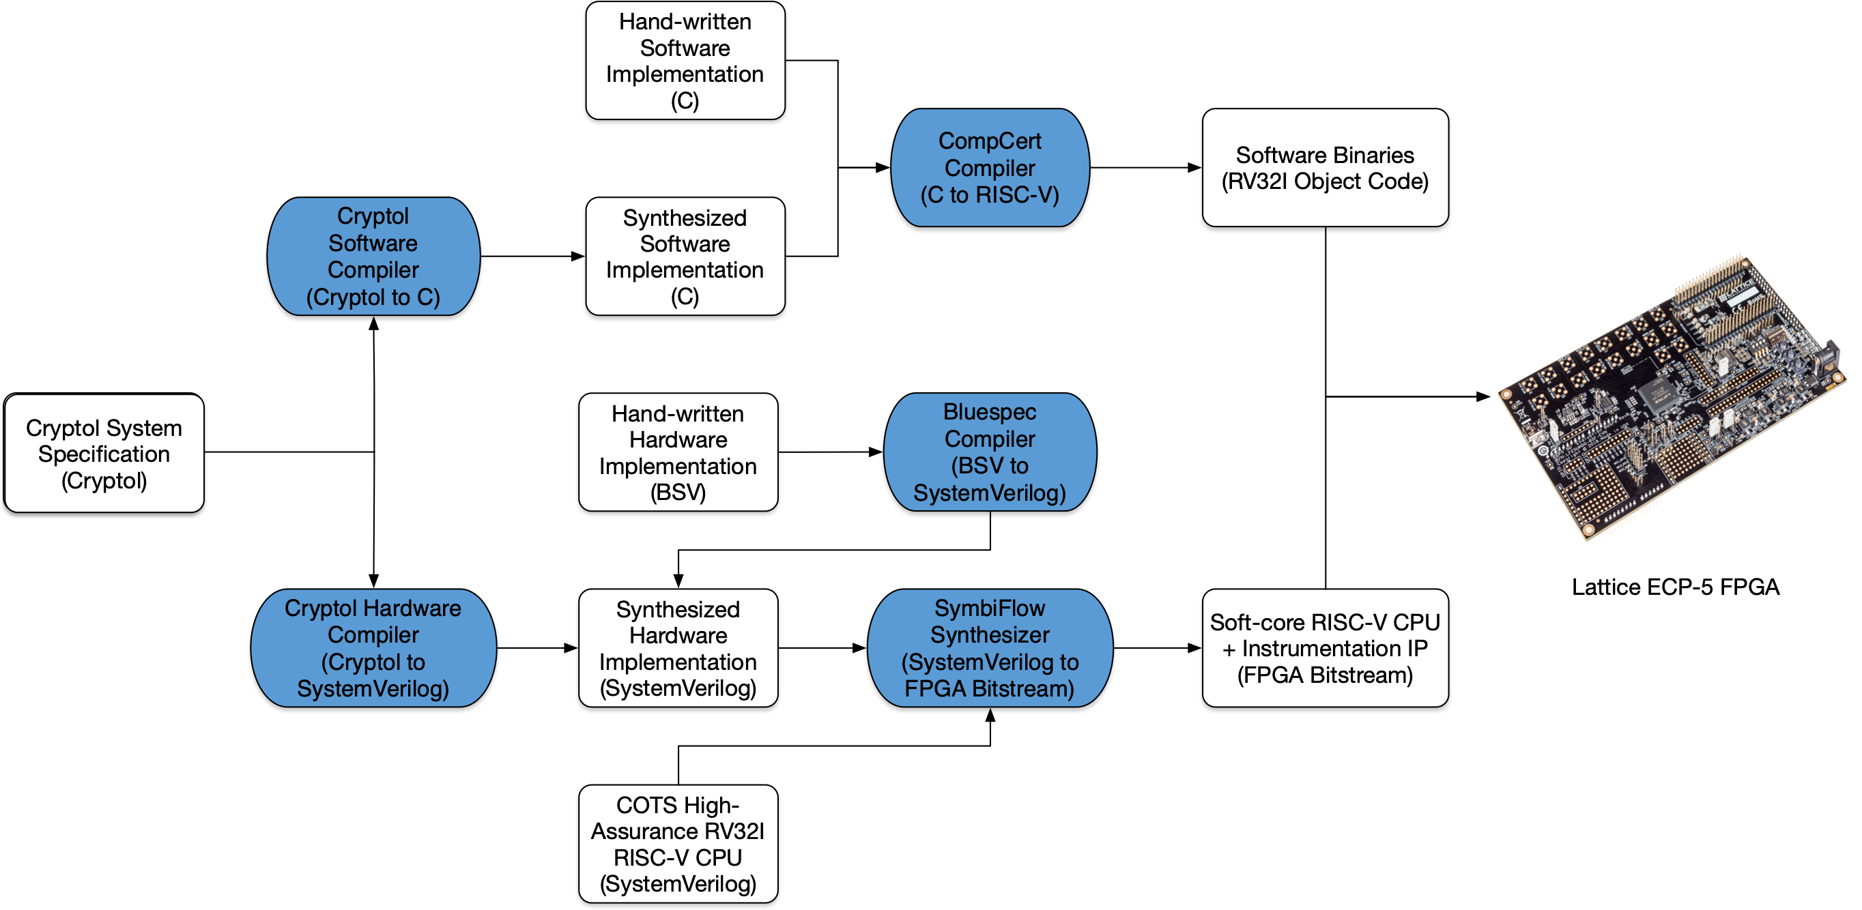
Implementation Artifacts and Relations

Slide 17
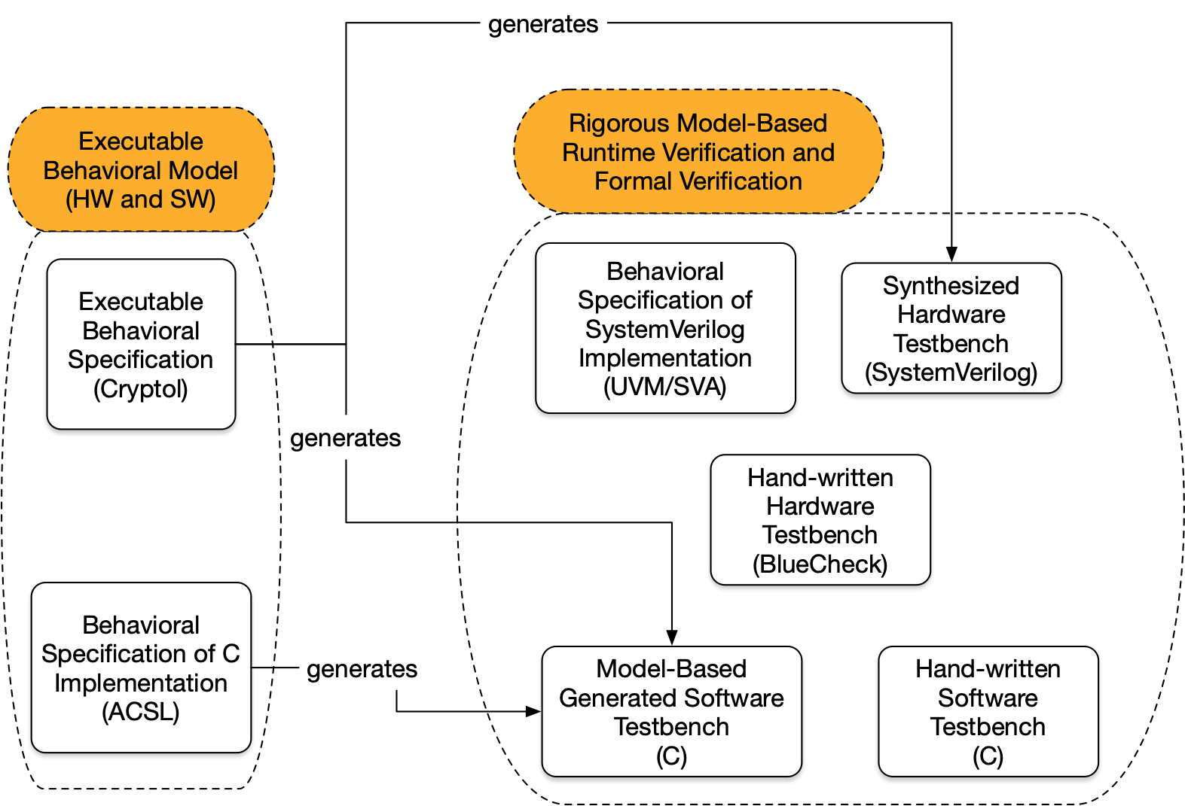
Generation of Assurance Artifacts

Slide 18
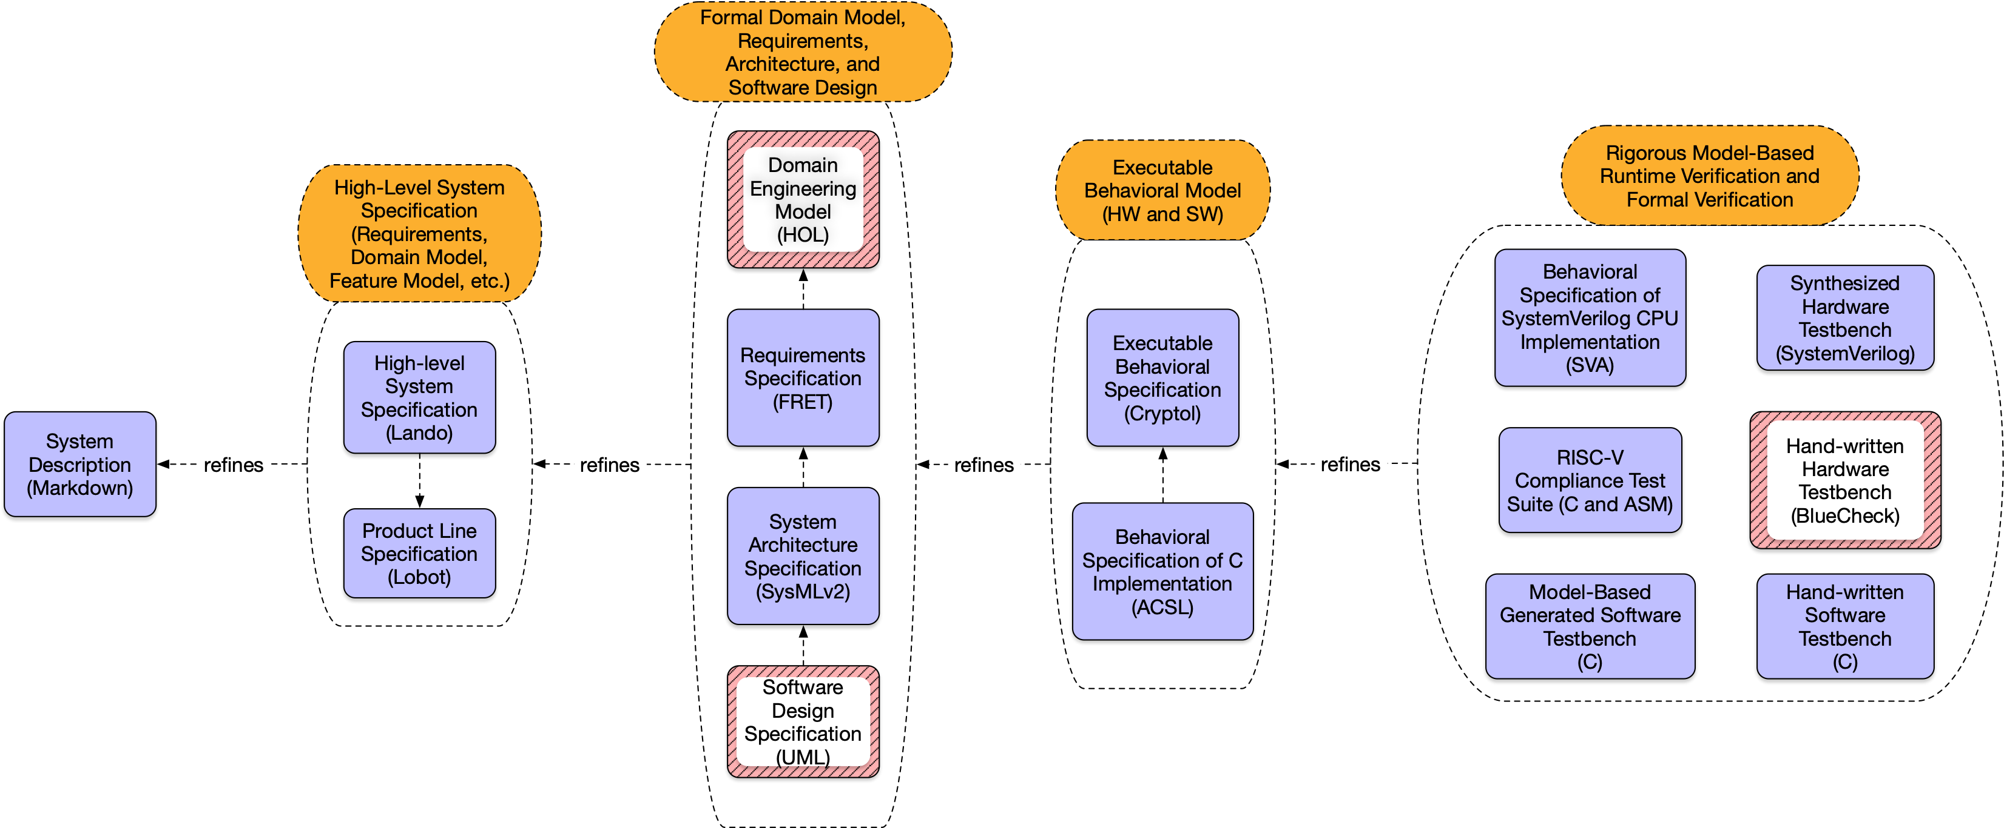
RTS Specification Artifacts

Slide 19
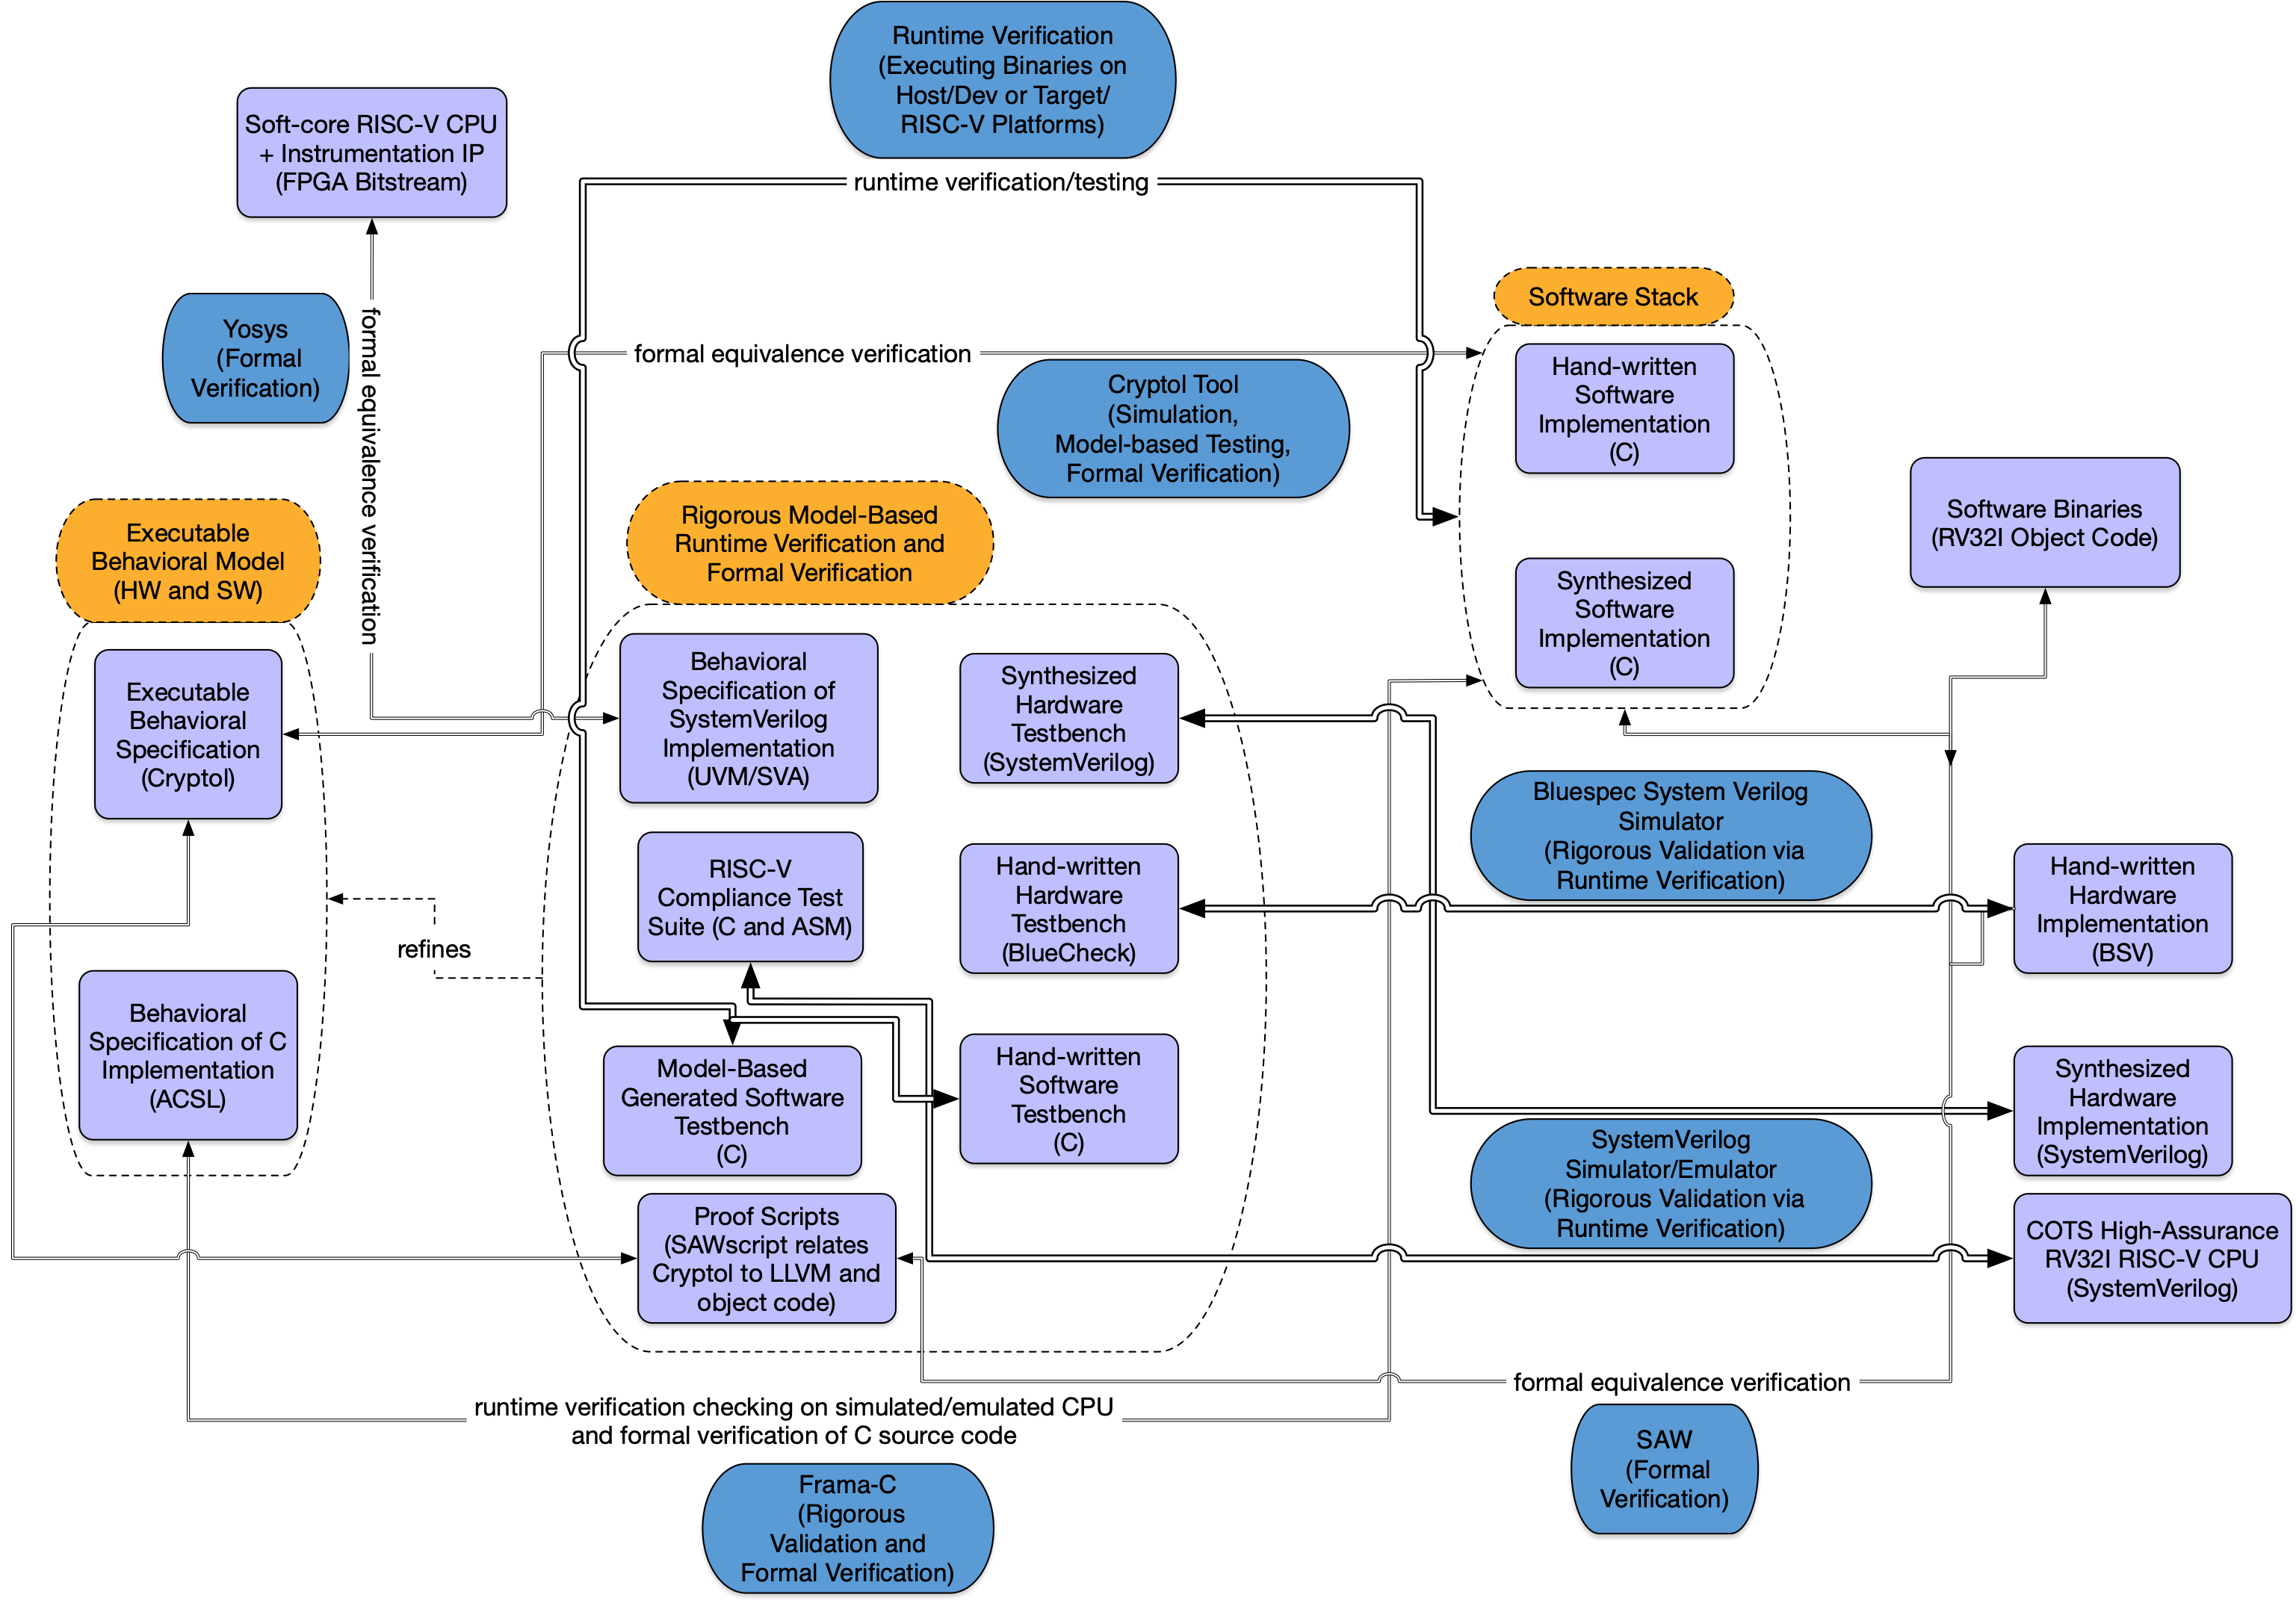
RTS Validation/Testing and Verification Artifacts

Slide 20
Kinds of Reasoning
one can reason about a thing (a model, a software implementation in source code, a binary, a hardware design at various abstraction levels, etc.) in many different ways
model check states
attempt to satisfy a preposition
interactively prove theorems
our tools automatically generate theorems about artifacts by statically translating the artifacts into their semantic representations,
embed that translation in a background theory of the universe of discourse (using, in part, the domain engineering model),
and then state and try to prove theorems about the relationship between artifacts

Slide 21
Equivalence and Refinement
The main relationships that we specify and reason about in our RDE are equivalence and refinement.
Equivalence means that two artifacts are “equal” under some formal equivalence relation defined in terms of the underlying semantics used to describe the artifacts.
Cryptol spec ≈ C program
C program ≈ Java program
LLVM bitcode ≈ Verilog spec
Equivalence facilities reasoning about correctness across models, languages, optimizations, evolution.
Refinement means that one artifacts “refines” another under some formal refinement relation defined in terms of the underlying semantics used to describe the artifacts.
C ⫤ ACSL ⫤ Cryptol ⫤ FRET ⫤ SysMLv2 ⫤ Lando ⫤ Markdown
SystemVerilog ⫤ SVA ⫤ Cryptol ⫤ FRET ⫤ SysMLv2 ⫤ etc.

Slide 22
Traceability as Refinement
traceability in our formal method is effected through refinement and is implicit and discoverable
when defined properly, refinement relations enable…
refinement checking
“Is A a refinement of B, and if so, how, and if not, why?”
model lifting
“What is a formal model of this artifact?”
model or code generation
“What is an artifact that refines this artifact?”
explicit annotations for traceability are only used to connect development artifacts to process
e.g., annotation of a design decision on a specification that links to a GitLab issue that provide evidence and provenance and connects to a specific signed pull request and release tags

Slide 23
Assurance Case
for high-assurance systems created with rigorous digital engineering, we must demonstrate that…
the specification which describes the system is the right specification (it is consistent, realizable, and has all of the properties we demand—aka spec validation)
all specifications relate to each other as specified to build the compositional argument of the system’s properties (equivalent specs are equivalent, specs that are refinements are refinements, etc.)
the implemented system conforms to its specifications (it is shaped like, and operates as, promised—no more, no less—in precisely characterized environments)
for HARDENS, in order to build this compositional assurance case we use the Lando type checker, the SysMLv2 type checker, FRET, Cryptol, SAW, Frama-C, and Yosys

Slide 24
Dynamic Assurance Case
dynamic assurance classically means “run hand-written tests on the real platform”
in the DevSecOps universe, it typically means “run hand-written and some automated tests on a test platform that is meant to duplicate the real one”
in the MBE universe, it means “run tests that are automatically generated from models on…”
in the Digital Engineering universe, it means “run tests on Digital Twins and the real platform…”
in the RDE universe, it means “run rigorously created (>>99% automatically generated and a bit of hand-written) parametrized property-based tests derived from theorems about the architecture and assurance goals on all digital twins and the real test and deployment platforms”

Slide 25
Dynamic Assurance for HARDENS
all Markdown requirements refine to SysMLv2 requirements refine to Cryptol properties (first-order theorems about the behavioral model) refine to property-based tests about the hardware and software
refinement from formal Cryptol properties results in…
theorems stated in ACSL about the software (at the unit, subsystem, and system level, & software device drivers),
theorems stated using Bluecheck, SVA, and UVM about the hardware (CPU & SoC & hardware device drivers), and
a software testbench is automatically generated from the Cryptol model by translating every theorem into a software property that is runtime or formally verified

Slide 26
Dynamic Assurance for HARDENS
all tests are run on…
the executable behavioral Cryptol model,
a POSIX emulation of the RTS hardware,
a hardware simulator of the CPU to verify that the CPU conformed to the RISC-V ISA spec and the (single-core and multi-core) SoC to verify SoC-level properties about devices, I/O, concurrency, and
the deployment hardware (the Lattice FPGA)
tests are run with RTS self-test enabled and disabled
the entire and test system is specified with a feature model and we aim to runtime verify all realizable models (e.g., identical results across three C compilers targeting three ISAs)

Slide 27
Model Validation
to ensure that our formal models are valid…
we use FRET to formally analyze the system requirements for consistency, completeness, and realizability
FRET's realizability checker, which verifies that for a set of input values satisfying the requirements, a set of output values exists that satisfy the requirements
dually, the tool identifies inputs for which no output is feasible, which helps narrow down subsets of requirements that are inconsistent.
we use Cryptol to demonstrate (either test automatic property-based testing or, in the main, formally prove) that all theorems about the Cryptol behavioral model hold
we use Frama-C to demonstrate that all theorems about the software model are consistent by attempting to prove “bottom”
we use Yosys to demonstrate through formal verification that all theorems about the hardware hold by attempting to prove “bottom”—the implementation that crashes—satisfies the spec

Slide 28
Hardware Formal Verification
our hardware has three kinds of components…
hardware device drivers for I/O
a 32-bit RISC-V CPU (NERV CPU from YosysHQ)
a single core and three core NERV-based SoC
thus we must verify…
each device driver conforms to its formal model
the CPU exactly conforms to a specific flavor of RISC-V
the SOC behaves exactly as we specify

Slide 29
Hardware Formal Verification
yosys is an open source tool suite that includes tools to synthesize bitstreams to some FGPAs and a formal verification tools that can perform equivalence checking & property-based verification
thus we use yosys to re-run the existing ISA formal verification on the CPU (as a kind of formal regression analysis), and
we runtime verify all SoC properties on the synthesized SoC (in simulation and on the FPGA)
we use our correct-by-construction tools to automatically synthesize hardware implementations of some of the architecture from the Cryptol model

Slide 30
Software Formal Verification
to formally verify the RTS software…
we use our correct-by-construction tools to generate some software components directly from the Cryptol model
then we use the SAW tool to further guarantee that the generated components are, in fact, correct through formal verification
we use formal static verification of the C source code
formally prove functional correctness relative to the Cryptol model, and
guarantee the absence of any runtime errors (e.g., due to array out-of-bounds errors and null pointers)

Slide 31
Digital Engineering Artifacts
our RDE model includes system models that capture everything from domain engineering model and requirements (Lando and SysMLv2) to low-level architectural structure and properties (SysMLv2, Cryptol, ACSL, and SVA)
we must demonstrate that our several digital twins are correct and are refinements of each other
we must understand and quantify their fidelity, assurance level, and performance

Slide 32
Digital Twins
the RTS system includes several digital twins
the executable behavioral Cryptol model,
a POSIX emulation of the RTS hardware,
a hardware simulator of the RISC-V CPU, and
the (single-core and multi-core) SoC
all system properties must be/are valid for all twins
there are several other twins we would like to add
a machine emulator model (QEMU) of the platform
a Bluespec event-based simulator of the SoC
a SystemC-based platform emulator such as Imperas’s
an alternative software-based hardware simulator such as Metrics’s cloud/LLVM-based simulator
Notes:
For example, our three core SoC running on an FPGA is a digital twin
of (1) the same three core SoC implemented as an ASIC, (2) three
single core SoCs running on an FPGA, or (3) three single core SoCs
running on three FPGAs connected via an AXI bus, or (4) three single
core ASICs connected on an AXI bus.

Slide 33
Digital Threads
a digital thread is a chain of properties that run through refinements of digital twins and the deployment platform
traceability via refinement guarantees that digital threads are sound and complete
from every relevant domain-specific concept in the domain engineering model to…
every system characteristic and requirement to…
every structural element and formal property of every model and digital twin…
to every structural element and formal property of the deployment hardware
threads are sound when their elements (theorems/properties) are shown to hold for every twin and target in the refinement chain
threads are complete when every abstract element is shown to hold for every twin and target in the refinement chain

Slide 34
Where is RDE going next?

Slide 35
Next Steps
there are enormous opportunities in the design and implementation of SysMLv2 to facilitate RDE
we need a formal, denotational, executable model of SysMLv2 to realize SysMLv2 digital twins directly and to define formal refinement relations to other formal models
we have a draft of a partial HOL model in PVS
we need a means by which to validate and verify SysMLv2 implementations are conformant to its formal semantics
we need an IDE that facilitates automatic refinement checking and refinement-based model lifting & generation
we need to define a refinement between SysMLv2 and AADL
we need high-quality, interactive graphical model editing, refactoring, and rendering
preferably defined via an equivalence relation between the textual and graphical semantics, and then extracted to an implementation
Notes:
Some of this is facilitated by our recent acquisition of Adventium Labs, and a lot of the rest is being attended to via a plus-up on CASE from DARPA I2O.

Slide 36
More Information
HARDENS Case Study https://github.com/GaloisInc/HARDENS (live on 1 June 2022)
Galois https://galois.com/ & https://lifeatgalois.com/
NRC https://www.nrc.gov/
Cryptol https://cryptol.net/
Lando https://github.com/GaloisInc/BESSPIN-Lando
SAW https://saw.galois.com/
Frama-C https://frama-c.com/
ACSL https://frama-c.com/html/acsl.html
FRET https://ti.arc.nasa.gov/tech/rse/research/fret/
Yosys https://www.yosyshq.com/
Coq https://coq.inria.fr/
PVS https://pvs.csl.sri.com/
Galois is hiring in this R&D area! https://galois.com/careers/

